Slide 1

Blogging Web Application

Slide 2
Blogging (Intro)
The act of creating and maintaining a blog.
Act of posting a content on a blog (a web log or online journal) or posting comments on someone else’s blog

Slide 3
Problem Statement
Due to the large amount of low-quality and unreliable information online, bloggers often struggle to establish trust with their audience. This makes it difficult for readers to find valuable and informative content, which leads to a decrease in engagement and audience growth for bloggers. To address this problem, a Blogging Web Application is needed that promotes reliable and informative content, provides tools for creating engaging posts, and helps bloggers build a reputation based on their expertise. This will help to make a positive impact on the online community

Slide 4
Objective
User-friendly platform for publishing content
Community-building for bloggers to connect and collaborate
Security and privacy for bloggers' content and personal information+ (jwt security)
Analytics tools to track blog performance and engagement

Slide 5
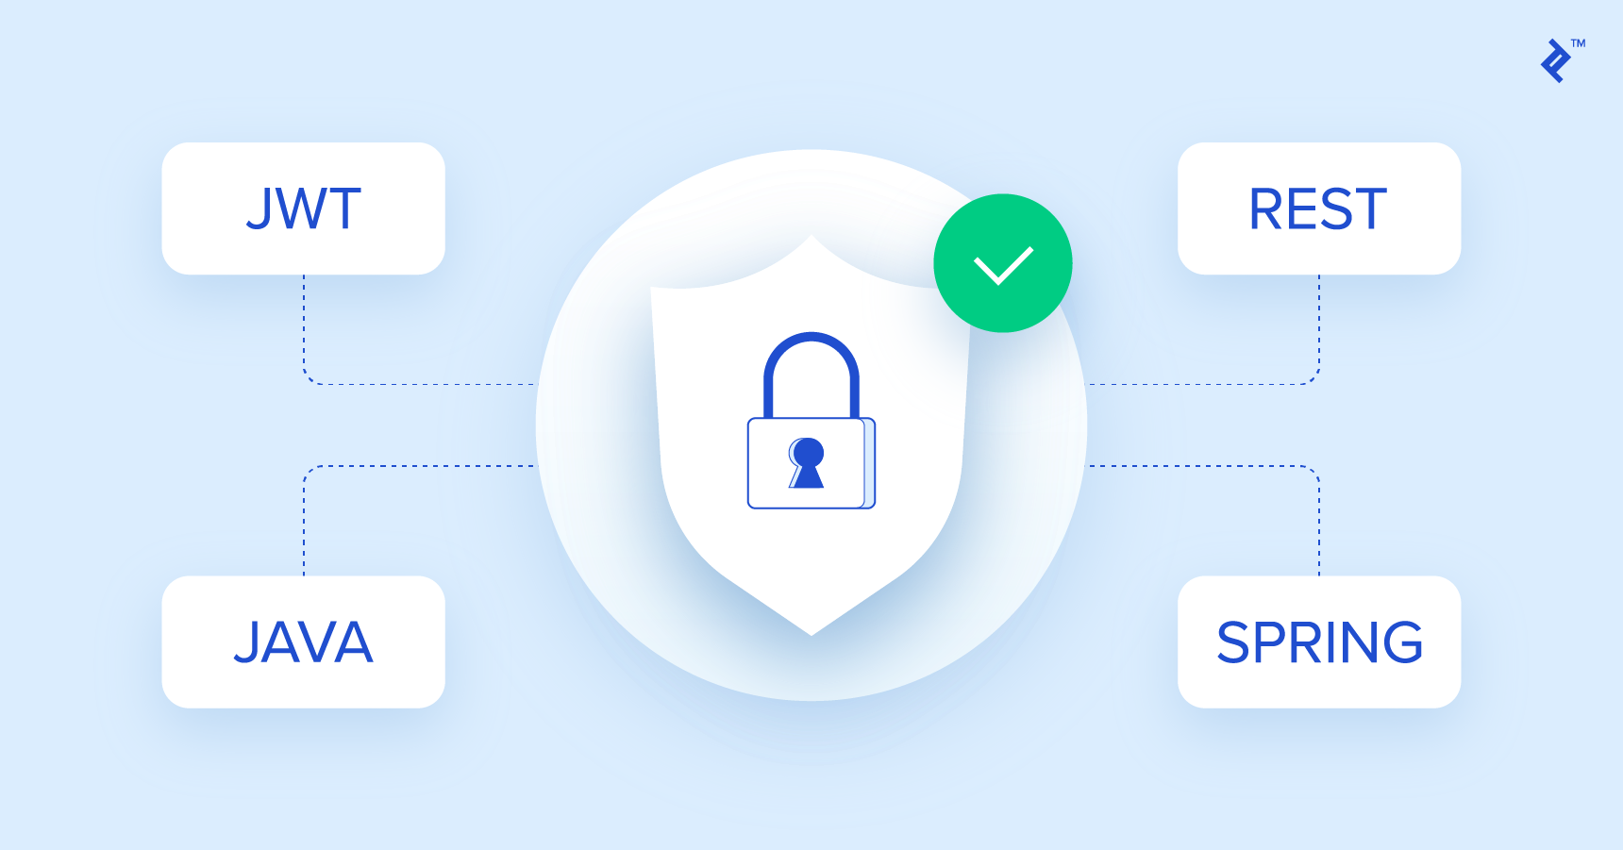
Security (objective)

Slide 6
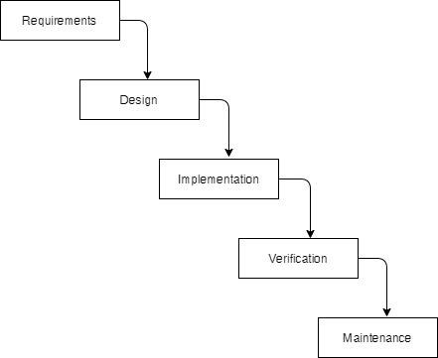
Methodology
Waterfall

Slide 7
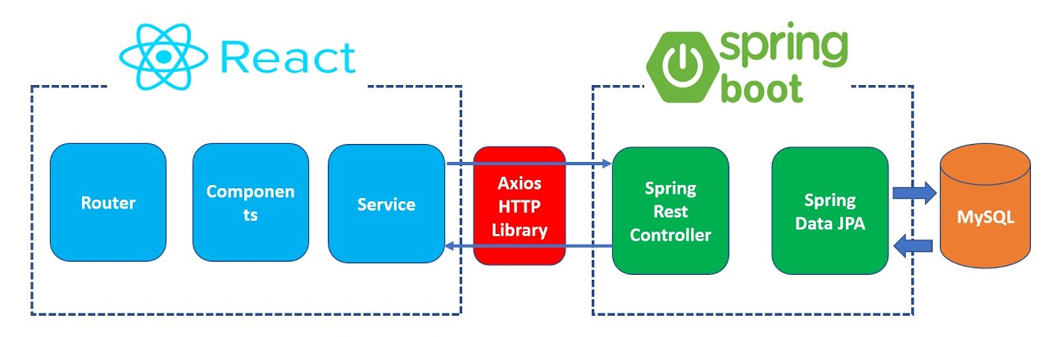
Tools and technique
Frontend
Backend

Slide 8
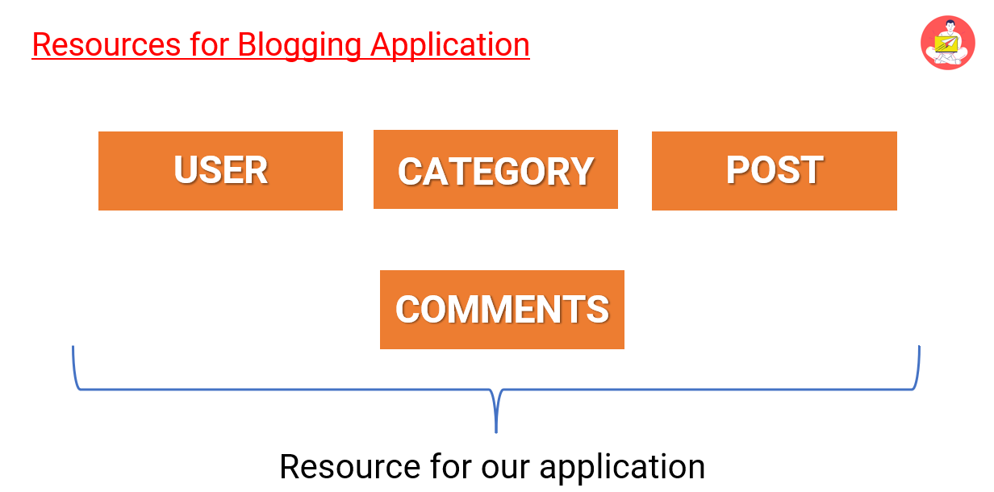
Main Module

Slide 9
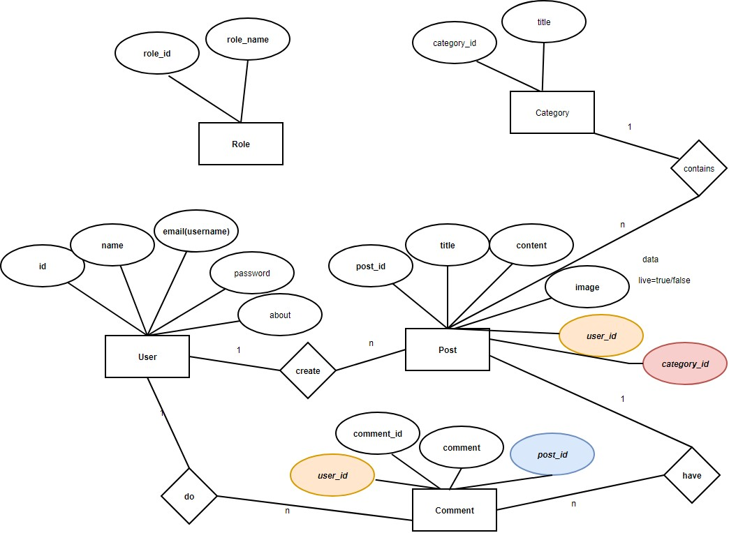

Slide 10
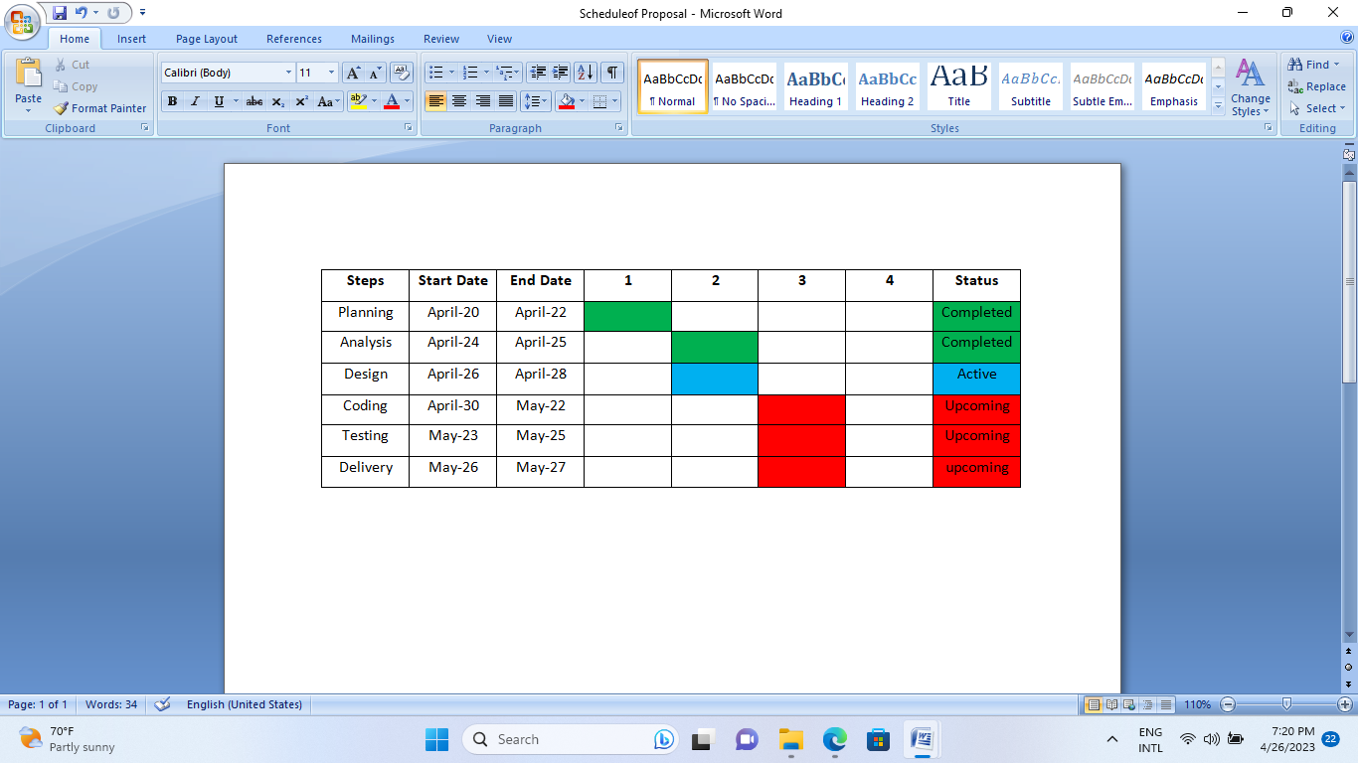
Project schedule

Slide 11
Resources
Human Resources:- As a solo developer, My Blogging Web app is ongoing…
Technical Resources:- laptop, Wi-Fi connection, and software tools like VS Code, STS tools, Spring Boot framework, and ReactJS will be essential for building and launching the platform.
Financial Resources:-till yet all most free
(open-source software )

Slide 12
Resources
Time and Effort :-significant amount of time and effort will be required to design, develop, test, and launch the platform.

Slide 13
Conclusion
In conclusion, as a solo developer, this Blogging Web App project will be a challenging but rewarding endeavor. With the help of technical resources such as a laptop, Wi-Fi, ChatGpt , and various development tools, and the commitment of time and effort, the project can be successfully completed.

